Slide 1
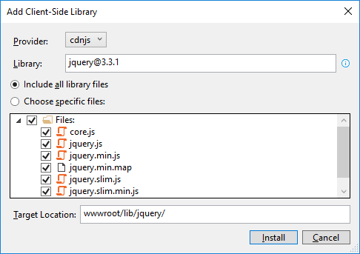
How to add the Bootstrap and jQuery libraries
Start Visual Studio and open a project. In the Solution Explorer, expand the wwwroot/lib folder and delete any old Bootstrap or jQuery libraries.
In the Solution Explorer, right-click on the project name and select the Add→Client-Side Library item.
In the dialog box that appears, “jquery@”, “popper.js”, “jquery-validate”, and “twitter-bootstrap”(but change the target location to “www/lib/bootstrap” for this one).

Slide 2
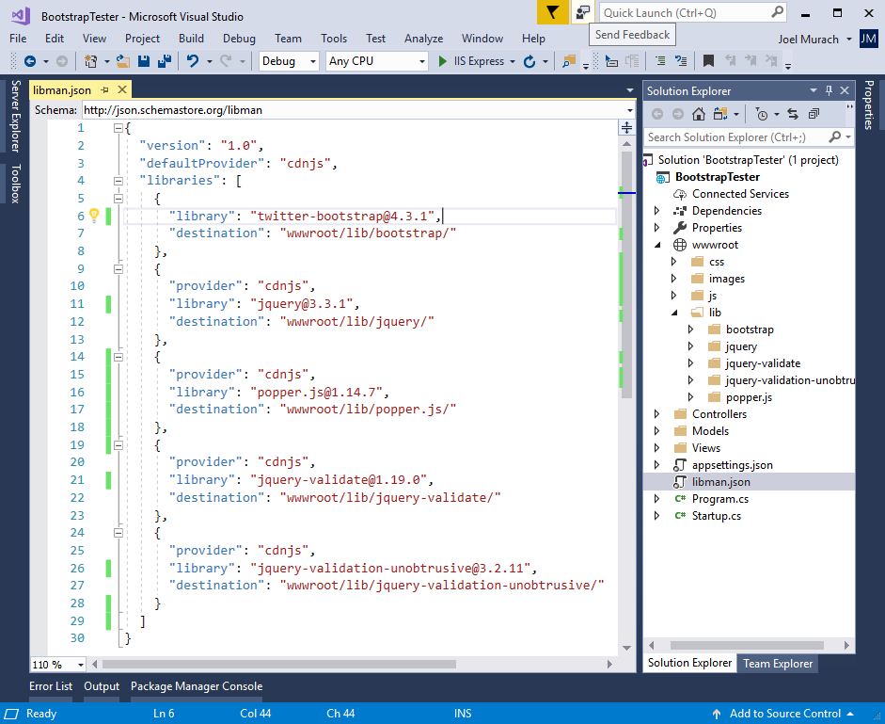
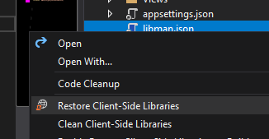
The libman.json file for the client-side libraries
Clean to delete
Restore to restore
(-> restores based on the dependencies written on the code)

Slide 3
A Razor layout that enables client-side libraries
<!DOCTYPE html>
<html>
<head>
<meta name="viewport" content="width=device-width" />
<title>@ViewData["Title"]</title>
<link rel="stylesheet"
href="~/lib/bootstrap/css/bootstrap.min.css" />
<link rel="stylesheet" href="~/css/custom.css" />
<script src="~/lib/jquery/jquery.min.js"></script>
<script src="~/lib/popper.js/popper.min.js"></script>
<script src="~/lib/bootstrap/js/bootstrap.min.js"></script>
<script src="~/lib/jquery-validate/
jquery.validate.min.js"></script>
<script src="~/lib/jquery-validation-unobtrusive/
jquery.validate.unobtrusive.min.js"></script>
</head>
<body>
@RenderBody()
</body>
</html>

Slide 4
An extra directory that may be included by the MVC template
<link rel="stylesheet"
href="~/lib/bootstrap/dist/css/bootstrap.min.css" />

Slide 5
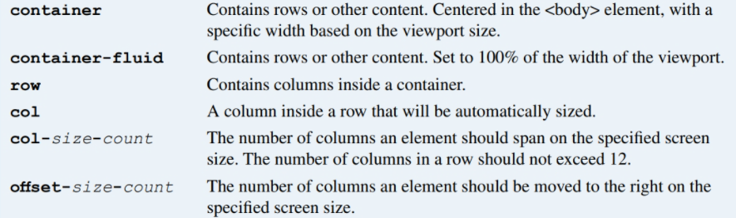
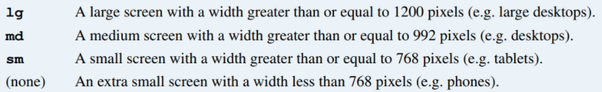
The URL for the Bootstrap documentation
https://getbootstrap.com/docs/
Valid Bootstrap class values
Valid size values

Slide 6
Two columns that are automatically sized
<div class="col">Column 1</div>
<div class="col">Column 2</div>
An element that spans four columns on medium and large screens
<div class="col-md-4">This element spans four columns</div>
An element that spans 4 columns on medium screens and 3 on large
<div class="col-md-4 col-lg-3">
This element spans three or four columns
</div>
An element that is moved one column to the right on medium screens
<div class="col-md-4 offset-md-1">
This element is offset by one column
</div>

Slide 7
The HTML for a grid
<main class="container">
<div class="row">
<div class="col-12">Column 1</div>
<div class="col-12">Column 2</div>
</div>
<div class="row">
<div class="col-md-4">Column 1</div>
<div class="col-md-8">Column 2</div>
</div>
<div class="row">
<div class="col-md-4 col-sm-6">Column 1</div>
<div class="col-md-8 col-sm-6">Column 2</div>
</div>
</main>

Slide 8
Custom CSS classes that override the Bootstrap CSS classes
.row { /* custom row styles */
margin-bottom: 0.5rem;
}
.row div { /* custom column styles */
border: 1px solid black;
padding: 0.5rem;
background-color: aliceblue;
}

Slide 9
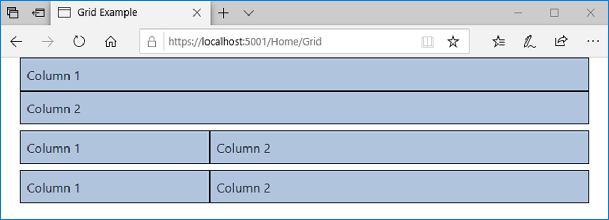
The Bootstrap grid on a medium screen

Slide 10
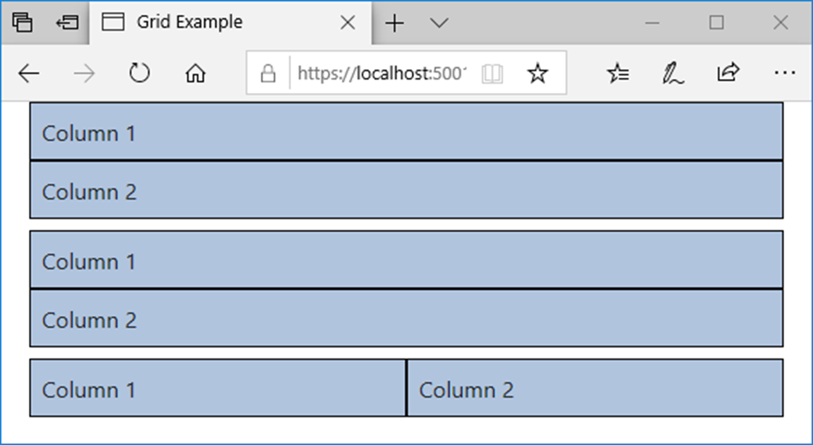
The Bootstrap grid on a small screen

Slide 11
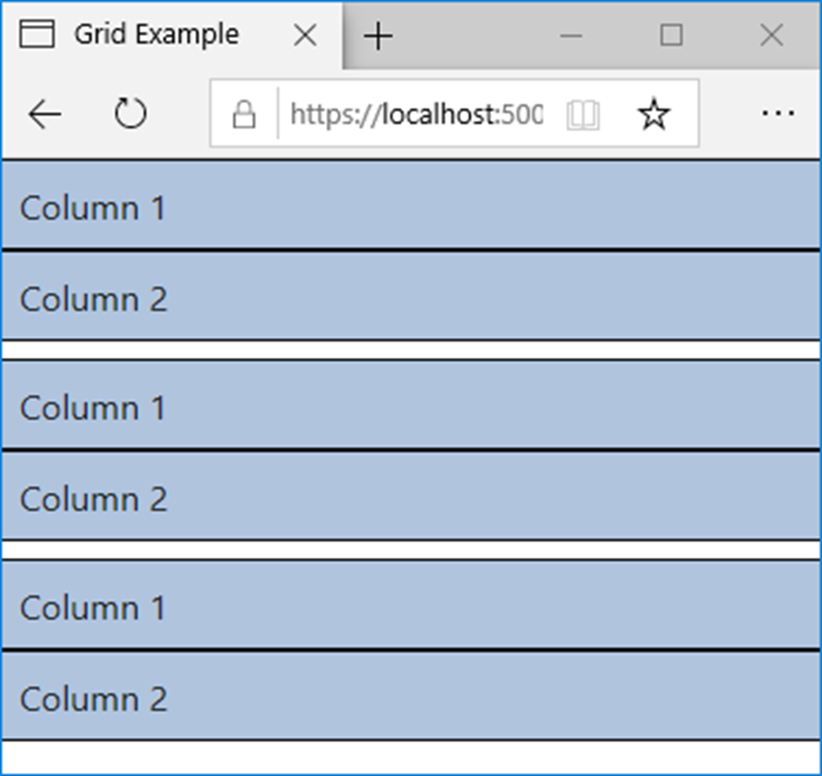
The Bootstrap grid on an extra small screen

Slide 12
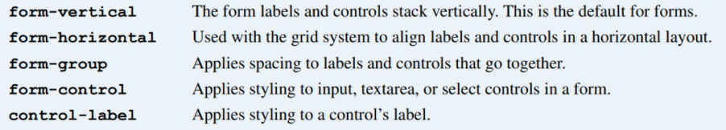
Bootstrap CSS classes for forms

Slide 13
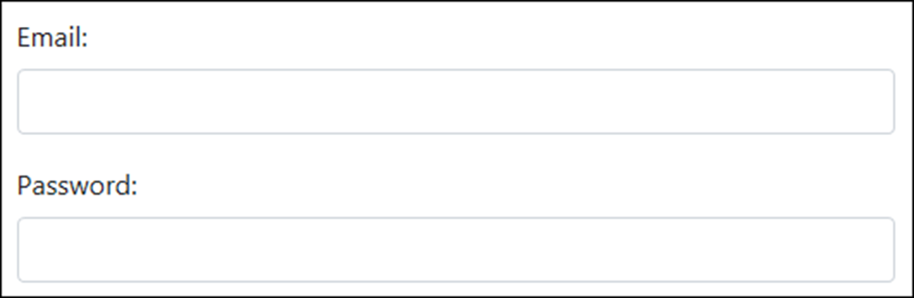
A form with two text boxes in vertical layout

Slide 14
The HTML for the form in vertical layout
<form asp-action="Login" method="post">
<div class="form-group">
<label for="email">Email:</label>
<input type="email" id="email" class="form-control" />
</div>
<div class="form-group">
<label for="pwd">Password:</label>
<input id="pwd" type="password" class="form-control" />
</div>
</form>

Slide 15
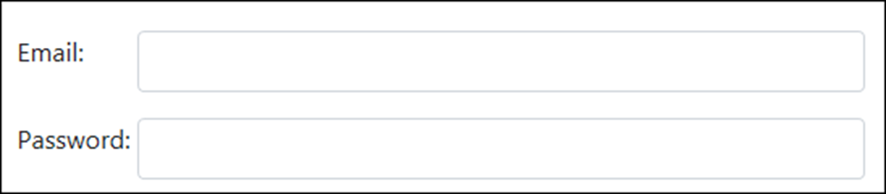
A form with two text boxes in horizontal layout

Slide 16
The HTML for the form in horizontal layout
<form asp-action="Login" method="post">
<div class="form-group row">
<label for="email" class="col-sm-2">Email:</label>
<div class="col-sm-10">
<input type="email" id="email" class="form-control" />
</div>
</div>
<div class="form-group row">
<label for="pwd" class="col-sm-2">Password:</label>
<div class="col-sm-10">
<input type="password" id="pwd" class="form-control" />
</div>
</div>
</form>

Slide 17
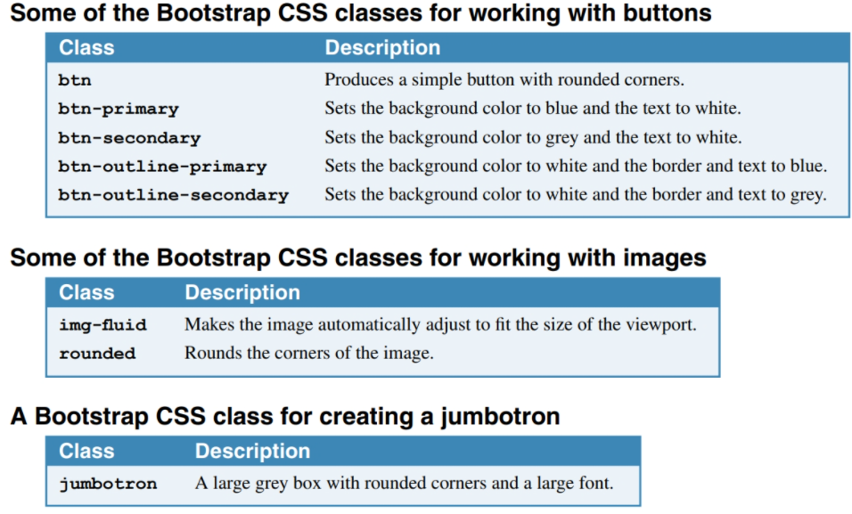

Slide 18
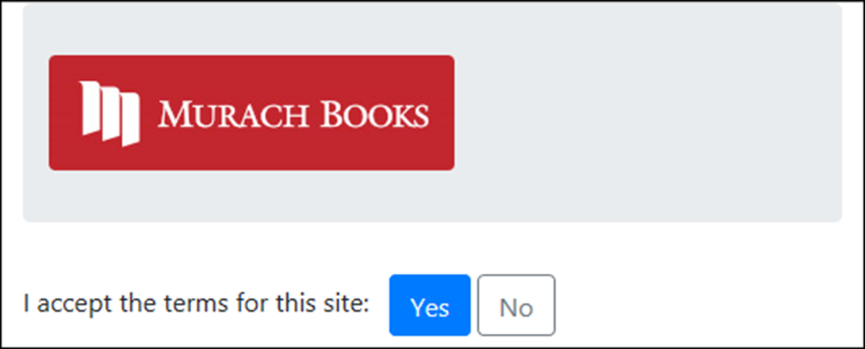
A jumbotron, an image, and two buttons

Slide 19
The HTML for the jumbotron, image, and buttons
<div class="container">
<header class="jumbotron">
<img id="logo" alt="Murach logo"
src="~/images/MurachLogo.jpg"
class="img-fluid rounded" />
</header>
<main>
<form asp-action="Index" method="post">
<span class="mr-2">I accept the terms for this site:
</span>
<button type="submit" class="btn btn-primary">
Yes
</button>
<button id="btnNo" class="btn btn-outline-secondary">
No
</button>
</form>
</main>
</div>

Slide 20
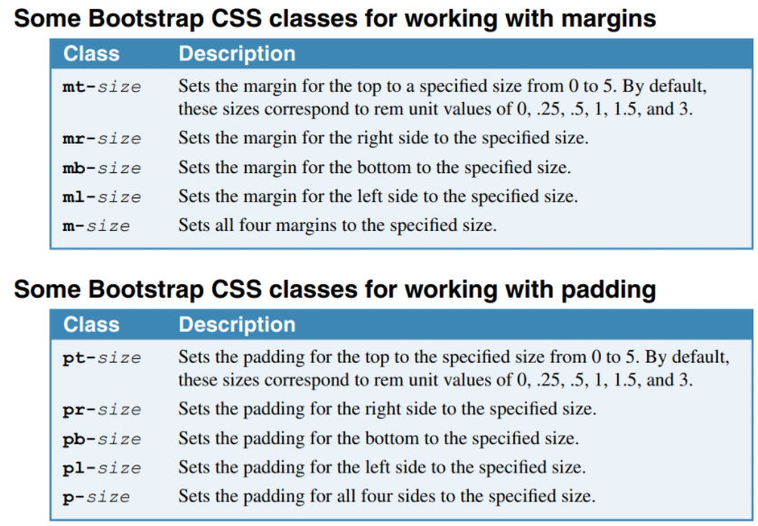

Slide 21
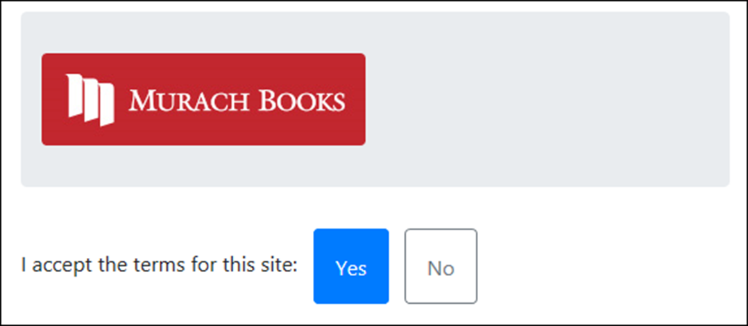
Some elements that use margins and padding

Slide 22
The HTML for the elements
<div class="container">
<header class="jumbotron mt-2">
<img id="logo" alt="Murach logo"
src="~/images/MurachLogo.jpg"
class="img-fluid rounded" />
</header>
<main>
<form asp-action="Index" method="post">
<span class="mr-2">
I accept the terms for this site:
</span>
<button type="submit"
class="btn btn-primary p-3 mr-2">Yes
</button>
<button id="btnNo"
class="btn btn-outline-secondary p-3">No
</button>
</form>
</main>
</div>

Slide 23
The code for the Index view (part 1)
@model FutureValueModel
@{
ViewBag.Title = "Future Value Calculator";
}
<div class="container">
<header class="jumbotron">
<img id="logo" alt="Murach logo"
src="~/images/MurachLogo.jpg"
class="img-responsive rounded" />
<h1 class="mt-3">@ViewBag.Title</h1>
</header>
<main>
<form asp-action="Index" method="post">
<div class="row form-group">
<label asp-for="MonthlyInvestment"
class="col-sm-3">Monthly Investment: </label>
<div class="col-sm-3">
<input asp-for="MonthlyInvestment"
class="form-control" />
</div>
<span asp-validation-for="MonthlyInvestment"
class="col text-danger"></span>
</div>

Slide 24
The code for the Index view (part 2)
<div class="row form-group">
<label asp-for="YearlyInterestRate"
class="col-sm-3">Yearly Interest Rate:
</label>
<div class="col-sm-3">
<input asp-for="YearlyInterestRate"
class="form-control" />
</div>
<span asp-validation-for="YearlyInterestRate"
class="col text-danger"></span>
</div>
<div class="row form-group">
<label asp-for="Years" class="col-sm-3">
Number of Years: </label>
<div class="col-sm-3">
<input asp-for="Years" class="form-control" />
</div>
<span asp-validation-for="Years"
class="col text-danger"></span>
</div>

Slide 25
The code for the Index view (part 3)
<div class="row form-group">
<label class="col-sm-3">Future Value:</label>
<div class="col-sm-3">
<input value="@ViewBag.FutureValue" readonly
class="form-control" />
</div>
</div>
<div class="row form-group">
<div class="col offset-sm-3">
<button type="submit" class="btn btn-primary">
Calculate</button>
<a asp-action="Index"
class="btn btn-outline-secondary">Clear</a>
</div>
</div>
</form>
</main>
</div>

Slide 26
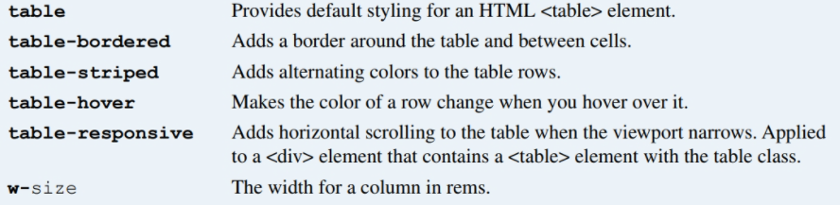
CSS classes for working with HTML tables

Slide 27
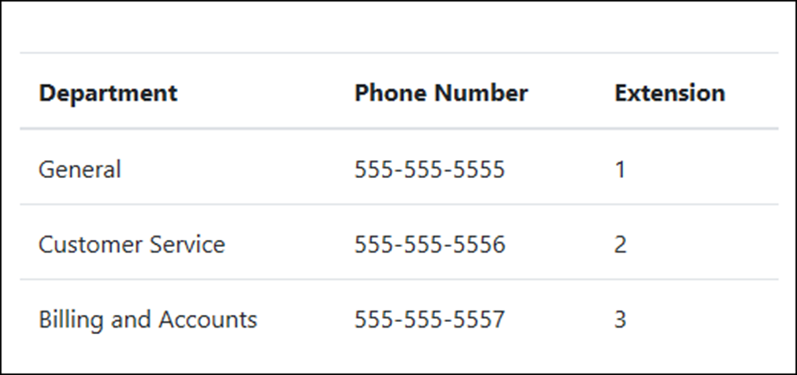
A table with default styling

Slide 28
The HTML for the table
<table class="table">
<thead>
<tr>
<th>Department</th>
<th>Phone Number</th>
<th>Extension</th></tr>
</thead>
<tbody>
<tr>
<td>General</td>
<td>555-555-5555</td>
<td>1</td></tr>
<tr>
<td>Customer Service</td>
<td>555-555-5556</td>
<td>2</td></tr>
<tr>
<td>Billing and Accounts</td>
<td>555-555-5557</td>
<td>3</td></tr>
</tbody>
</table>

Slide 29
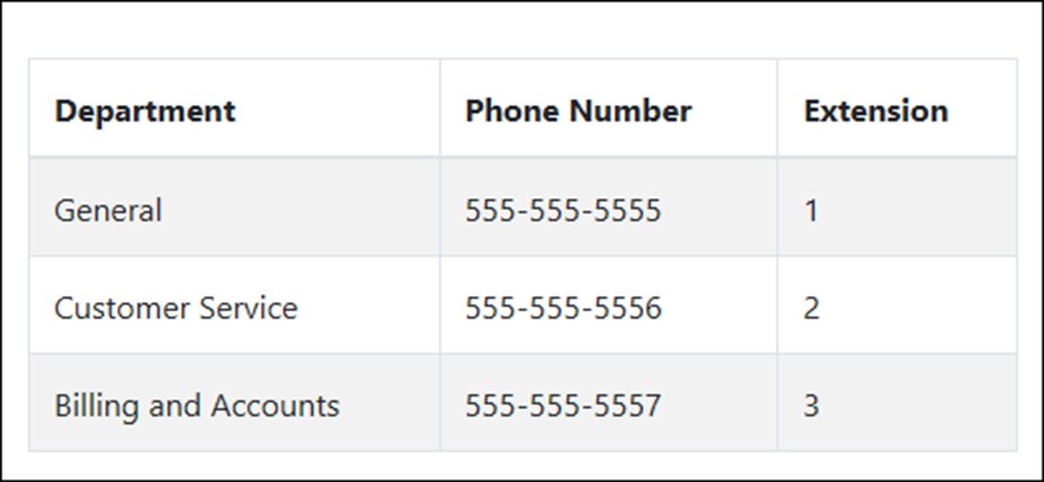
A table with alternating stripes and borders
The HTML for the table
<table class="table table-striped table-bordered table-hover">...

Slide 30
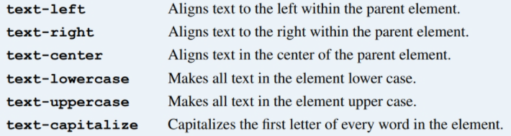
Common CSS classes for text

Slide 31
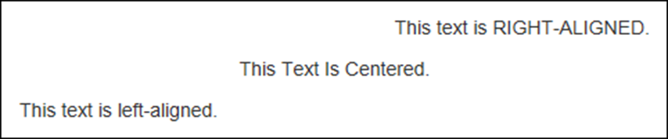
Some examples of the text CSS classes
The HTML for the text
<p class="text-right">
This text is <span class="text-uppercase">
right-aligned</span>.
</p>
<p class="text-center">
<span class="text-capitalize">This text is centered.
</span>
</p>
<p class="text-left">
This text is <span class="text-lowercase">
LEFT-ALIGNED</span>.
</p>

Slide 32
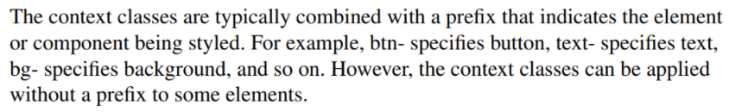
The context classes available to most elements
Class Default color
primary Dark blue
secondary Gray
success Green
info Light blue
warning Orange
danger Red
light White
dark Gray

Slide 33
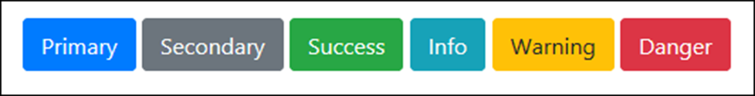
Some of the context classes applied to buttons
The HTML for the buttons
<button class="btn btn-primary">Primary</button>
<button class="btn btn-secondary">Secondary</button>
<button class="btn btn-success">Success</button>
<button class="btn btn-info">Info</button>
<button class="btn btn-warning">Warning</button>
<button class="btn btn-danger">Danger</button>

Slide 34
The success class applied to the text of an element
The HTML for the element
<p class="text-success">
Congratulations! You are now registered.
</p>

Slide 35

The warning class applied to the background of an element
The HTML for the element
<p class="bg-warning p-2 rounded">
Warning! Some required fields are empty.
</p>

Slide 36
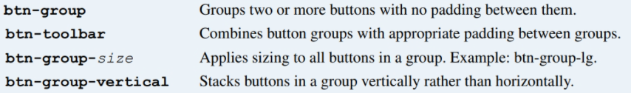
Common CSS classes for creating button groups

Slide 37
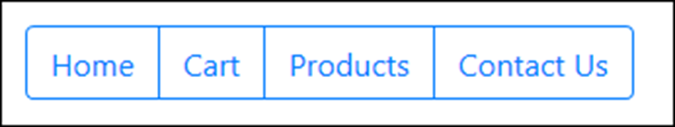
A basic button group
The HTML for the button group
<div class="btn-group" role="group"
aria-label="Button group">
<a href="/" class="btn btn-outline-primary">Home</a>
<a href="/cart" class="btn btn-outline-primary">
Cart</a>
<a href="/products" class="btn btn-outline-primary">
Products</a>
<a href="/contact-us" class="btn btn-outline-primary">
Contact Us</a>
</div>

Slide 38
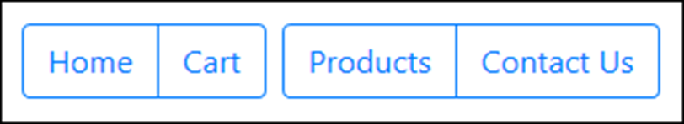
A toolbar with two button groups
The HTML for the button groups
<div class="btn-toolbar" role="toolbar"
aria-label="Toolbar with groups">
<div class="btn-group mr-2" role="group"
aria-label="First group">
<a href="/" class="btn btn-outline-primary">Home</a>
<a href="/Cart" class="btn btn-outline-primary">Cart</a>
</div>
<div class="btn-group" role="group" aria-label="Second group">
<a href="/products" class="btn btn-outline-primary">
Products</a>
<a href="/contact-us" class="btn btn-outline-primary">
Contact Us</a>
</div>
</div>

Slide 39
The URL for the Font Awesome website
https://fontawesome.com/
A typical <link> element that enables Font Awesome icons
<link rel="stylesheet"
href="https://use.fontawesome.com/releases/v5.8.1/css/all.css"
integrity="sha-long-hash_code" crossorigin="anonymous">

Slide 40

A button group that includes icons for its buttons
The HTML for the button group
<div class="btn-group" role="group"
aria-label="Button group">
<a href="/" class="btn btn-outline-primary">
<span class="fas fa-home"></span>&nbsp;Home&nbsp;
</a>
<a href="/cart" class="btn btn-outline-primary">
<span class="fas fa-shopping-cart"></span>
&nbsp;Cart&nbsp;
</a>
</div>

Slide 41
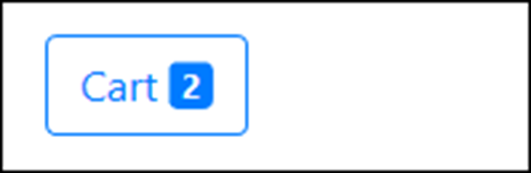
A button with a badge
The HTML for the button
<a href="/cart" class="btn btn-outline-primary">
&nbsp;Cart&nbsp;
<span class="badge badge-primary">2</span>
</a>

Slide 42
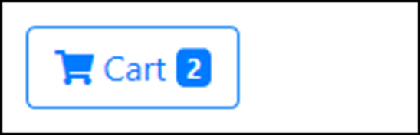
A button with an icon and a badge
The HTML for the button
<a href="/cart" class="btn btn-outline-primary">
<span class="fas fa-shopping-cart">
</span>&nbsp;Cart&nbsp;
<span class="badge badge-primary">2</span>
</a>

Slide 43
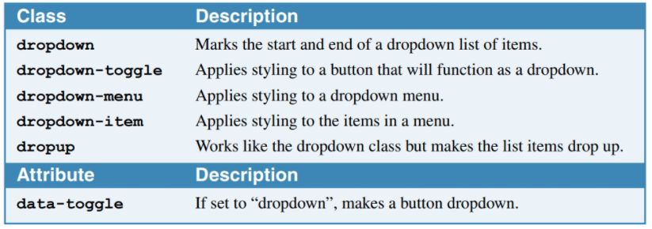
CSS classes for creating button dropdowns

Slide 44
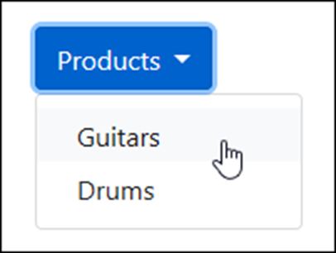
A button dropdown
The HTML for the button dropdown
<div class="dropdown">
<button type="button" class="btn btn-primary dropdown-toggle"
id="productsDropdown" data-toggle="dropdown"
aria-haspopup="true" aria-expanded="false">Products
</button>
<div class="dropdown-menu" aria-labelledby="productsDropdown">
<a class="dropdown-item"
href="/product/list/guitars">Guitars</a>
<a class="dropdown-item"
href="/product/list/drums">Drums</a>
</div>
</div>

Slide 45
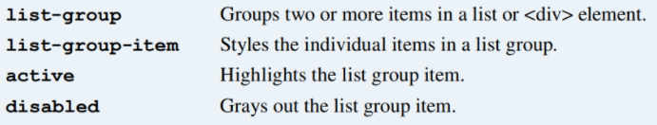
Common CSS classes for creating list groups

Slide 46
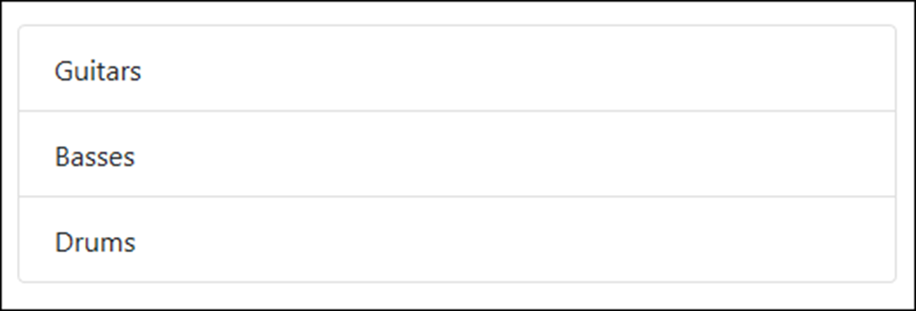
A basic list group
The HTML for the list group
<ul class="list-group">
<li class="list-group-item">Guitars</li>
<li class="list-group-item">Basses</li>
<li class="list-group-item">Drums</li>
</ul>

Slide 47
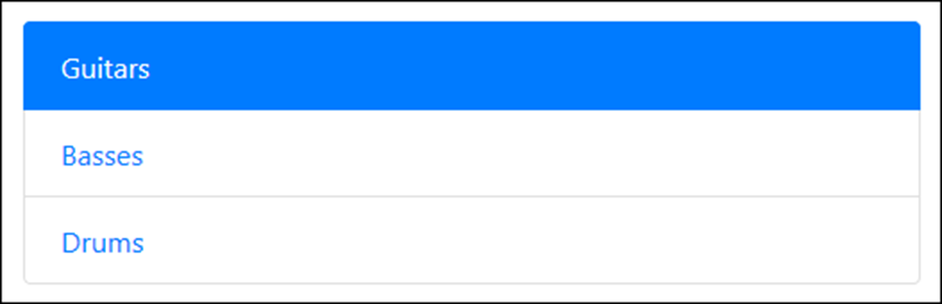
Another basic list group with an active item
The HTML for the list group
<div class="list-group">
<a href="/guitars" class="list-group-item active">
Guitars</a>
<a href="/basses" class="list-group-item">Basses</a>
<a href="/drums" class="list-group-item">Drums</a>
</div>

Slide 48
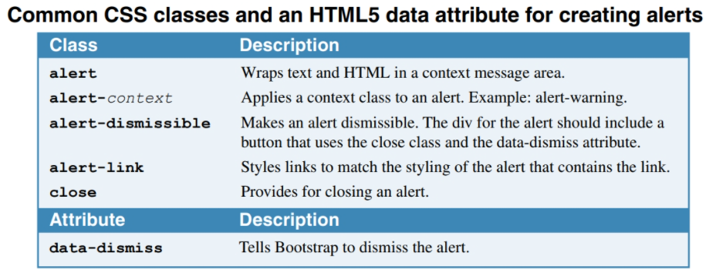

Slide 49
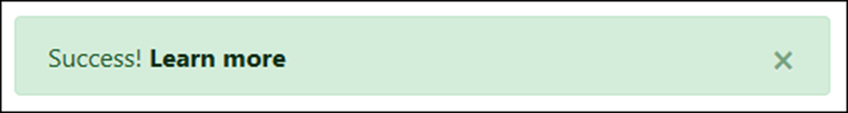
A dismissible alert with a link
The HTML for the alert
<div class="alert alert-success alert-dismissible">
<button class="close" data-dismiss="alert">
&times;
</button>
Success! <a href="#" class="alert-link">
Learn more</a>
</div>

Slide 50
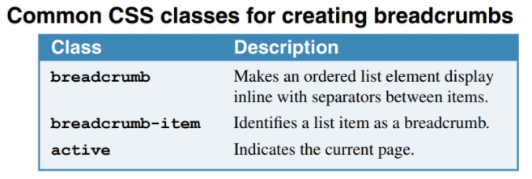

Slide 51
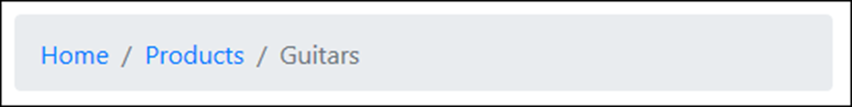
A breadcrumb with three segments
The HTML for the breadcrumb
<nav aria-label="breadcrumb">
<ol class="breadcrumb">
<li class="breadcrumb-item">
<a href="/">Home</a>
</li>
<li class="breadcrumb-item">
<a href="/Products">Products</a>
</li>
<li class="breadcrumb-item active"
aria-current="page">Guitars
</li>
</ol>
</nav>

Slide 52
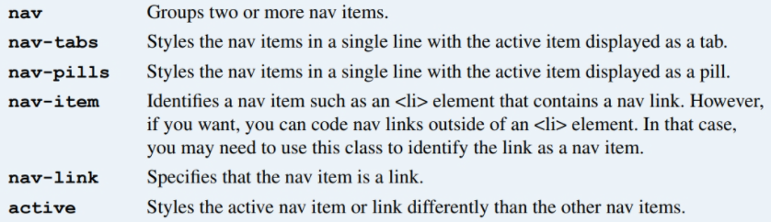
Common CSS classes for creating navs

Slide 53
Nav links styled as tabs
The HTML for the nav links
<nav class="nav nav-tabs">
<a class="nav-item nav-link active" href="/">Home</a>
<a class="nav-item nav-link" href="/products">
Products</a>
<a class="nav-item nav-link" href="/cart">Cart</a>
</nav>

Slide 54
The same nav links styled as pills
The HTML for the nav links
<nav class="nav nav-pills">
<a class="nav-item nav-link active" href="/">Home</a>
<a class="nav-item nav-link" href="/products">
Products</a>
<a class="nav-item nav-link" href="/cart">Cart</a>
</nav>

Slide 55
A more verbose way of coding the same nav links
<ul class="nav nav-pills">
<li class="nav-item">
<a class="nav-link active" href="/">Home</a>
</li>
<li class="nav-item">
<a class="nav-link" href="/products">Products</a>
</li>
<li class="nav-item">
<a class="nav-link" href="/cart">Cart</a>
</li>
</ul>

Slide 56
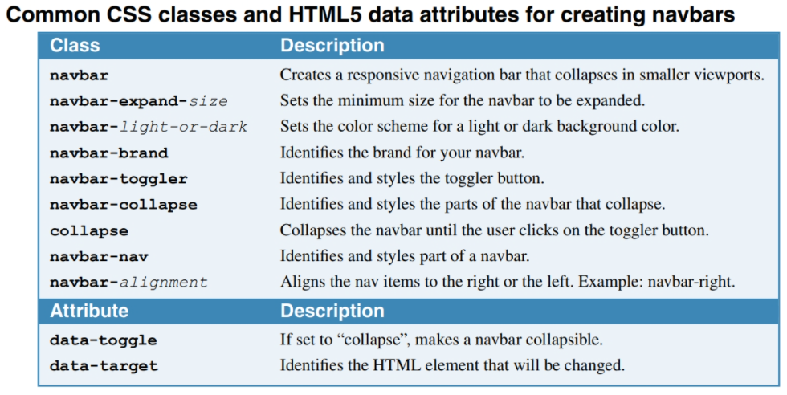
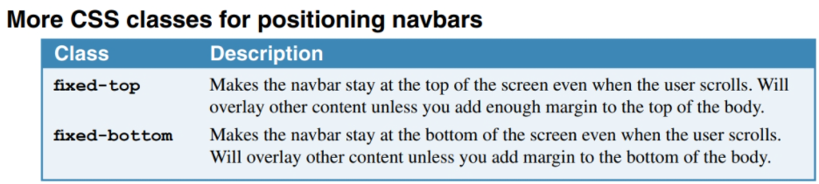

Slide 57
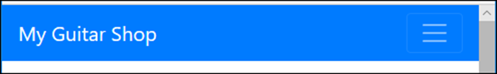
A navbar expanded on a wide screen
A navbar expanded on a small screen

Slide 58
The HTML for the navbar (part 1)
<nav class="navbar navbar-expand-md navbar-dark bg-primary">
<a class="navbar-brand" href="/">My Guitar Shop</a>
<button class="navbar-toggler" type="button"
data-toggle="collapse"
data-target="#navbarSupportedContent"
aria-controls="navbarSupportedContent"
aria-expanded="false"
aria-label="Toggle navigation">
<span class="navbar-toggler-icon"></span>
</button>
<nav class="collapse navbar-collapse"
id="navbarSupportedContent">
<div class="navbar-nav mr-auto">
<a class="nav-item nav-link active" href="/">Home</a>
<a class="nav-item nav-link"
href="/products">Products</a>
<a class="nav-item nav-link" href="/about">About</a>
</div>

Slide 59
The HTML for the navbar (part 2)
<div class="navbar-nav navbar-right">
<a class="nav-item nav-link" href="/cart">
<span class="fas fa-shopping-cart"></span>
&nbsp;Cart&nbsp;
<span class="badge badge-primary">2</span>
</a>
</div>
</nav>
</nav>

Slide 60
More CSS classes for positioning navbars
fixed-top
fixed-bottom

Slide 61
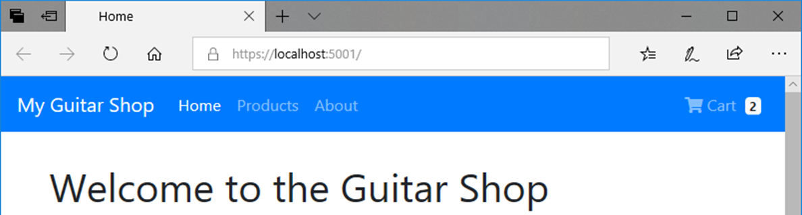
A navbar that’s fixed at the top of the screen

Slide 62
The HTML that displays the navbar
<body>
<nav class="navbar navbar-expand-md navbar-dark
bg-primary fixed-top">
<!-- navbar items go here -->
</nav>
<div class="container">
<!-- container items go here -->
</div>
</body>
The CSS that sets the top margin
body {
margin-top: 70px;
}

Slide 63
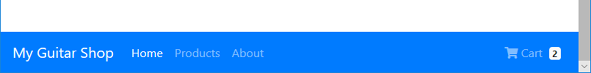
A navbar that’s fixed at the bottom of the screen

Slide 64
Bootstrap
By Randy Daigle
PROG2230
ACSIT

Slide 65
Objectives
Define responsive web design and describe how it supports an optimal experience on a variety of devices
Apply client-side web development frameworks to develop responsive websites and apps

Slide 66
What is RWD?

Slide 67
What is Responsive Web Design (RWD)
RWD allows developers to create a website that can change its layout dynamically
Developers can therefore create a single design that works on multiple devices: mobile phones, tablets, PCs, etc…
That is, apps/sites designed responsively are generally fluid designs – that is:
They readjust themselves according to the size of the screen they are viewed in, and
Are also compatible with the touch interfaces of phones & tablets

Slide 68
For instance…
Using a sequence of images from the book “Jump Start Bootstrap” by Syed Fazle Rahma we can best illustrate the point
Suppose you had a blog-based web site/app that looked as follows on a PC (desktop/laptop):

Slide 69
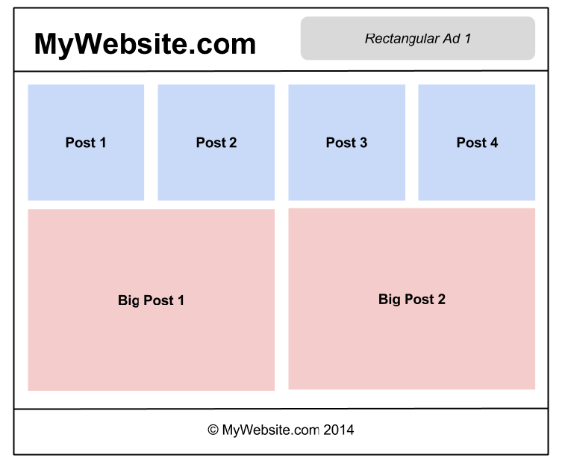

Slide 70
Which…
On a tablet we might want it to look like the following…

Slide 71
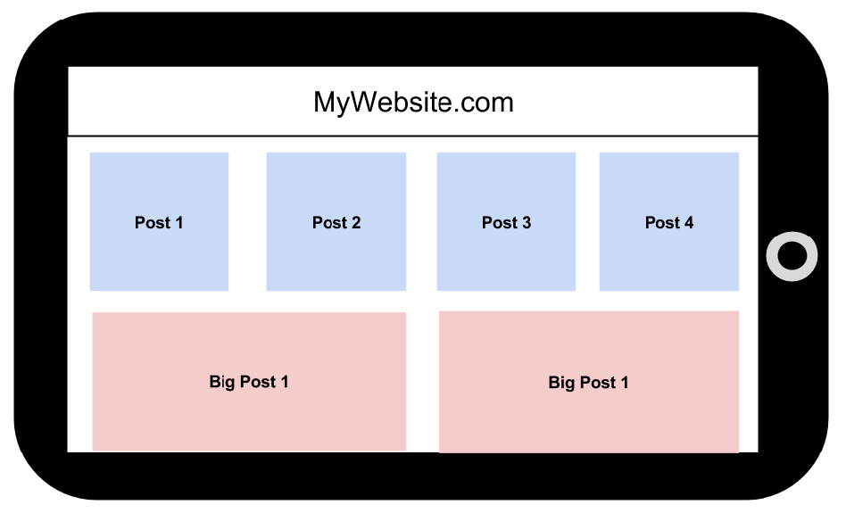

Slide 72
And…
On a phone we might want it at follows:

Slide 73
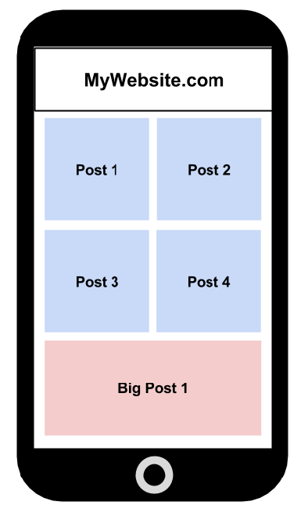

Slide 74
Here is another...
Reference that illustrates some key principles of RWD:
http://blog.froont.com/9-basic-principles-of-responsive-web-design/

Slide 75
Bootstrap: Introduction

Slide 76
What is Bootstrap?
From http://getbootstrap.com/, Bootstrap is:
“The most popular front-end framework for developing responsive, mobile first projects on the web.”
That is, Bootstrap is a client-side framework that supports RWD – i.e. the design and development of responsive web apps/sites
Created and open sourced by Twitter

Slide 77
A word of warning
Yes, Bootstrap is a framework that supports RWD…
But be under no illusion – RWD is extremely hard to do really well
i.e. to do well enough where your web site/app looks good and functions well on any device and screen size
So hard that some don’t even try – rather they develop a separate site/app for different devices
This path is only sustainable if all the heavy lifting is done on the server – e.g. via a RESTful service

Slide 78
Getting started
Let’s dive right into the HTML and CSS to get started
Here is the venerable “hello world” in Bootstrap that can hereafter serve as a starting template…

Slide 79
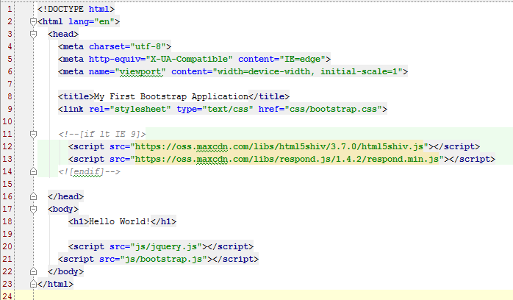
“Hello world” Bootstrap

Slide 80
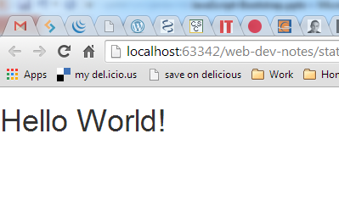
Which produces…
Note: the font of course is chosen by Bootstrap!

Slide 81
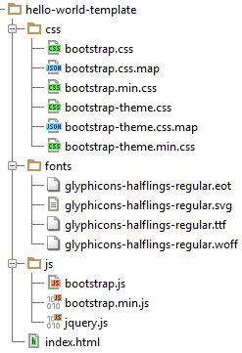
The file structure for this template
Let’s explore some of these files

Slide 82
A footnote:
If you want a sense of how complicated the work is that Bootstrap (and other CSS frameworks) does behind the scenes:
http://www.sitepoint.com/easy-responsive-css-grid-layouts/

Slide 83
Bootstrap: The Container

Slide 84
Bootstrap’s top-level containers
Bootstrap's grid system, which we’ll dive into next, allows you to specify rows and columns of your layout
But these rows and columns are contained within Bootstrap’s top-level container elements
These come in 2 forms:
Fixed width, and
Fluid width
Both have a left & right padding of 15px

Slide 85
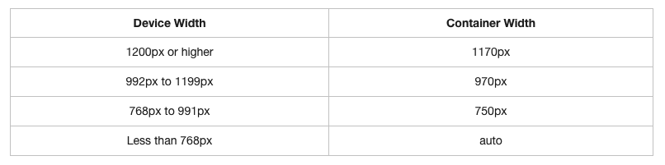
Fixed width containers
Have different fixed widths in different sized devices, as shown in this table:

Slide 86
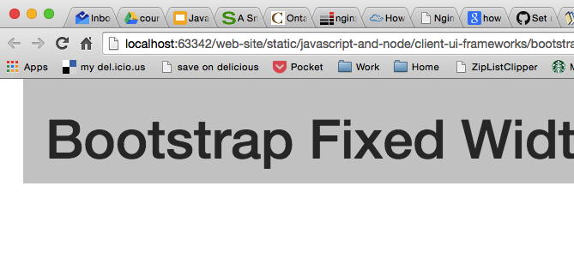
A fixed width example:
<div class="container">
<h1>Bootstrap Fixed Width Container</h1>
</div>

Slide 87

And a fluid width example:
<div class="container-fluid">
<h1>Bootstrap Fluid Width Container</h1>
</div>

Slide 88
Where...
Fluid-width containers do not have a fixed width
i.e. they are always the width of the device
So next…
What do we put in these containers?

Slide 89
Bootstrap: The “Grid System”

Slide 90
Bootstrap’s 12 column grid system
Bootstrap's grid system divides the screen into columns―up to a maximum of 12 in each row
The column widths vary according to the size of screen they're displayed in
i.e. the grid system is responsive - the columns resize themselves dynamically when the size of browser window changes
You can create any number of rows
The intersection of these rows and columns forms the grid to contain your site's content

Slide 91

For example
As a first grid-based layout example:
1 row with 2 sections each taking up 6 columns of the grid
Bootstrap CSS classes
(more on “xs” later)
Our own CSS classes

Slide 92

Which produces…

Slide 93

Note
Here we are style our columns in our own CSS file
i.e. outside the Bootstrap CSS files

Slide 94
Next, consider…
An example having two rows with each spanning a differing number columns

Slide 95


Slide 96

Which produces…

Slide 97

And here…
The CSS used is:

Slide 98
Bootstrap’s screen size codes
Bootstrap using the following size codes:
col-xs-
For extra small displays - i.e. screen width < 768px
col-sm-
For smaller displays – i.e screen width ≥ 768px
col-md-
For medium displays – i.e. screen width ≥ 992px
col-lg-
For larger displays – i.e. screen width ≥ 1200px

Slide 99
Think of these…
Codes (e.g. “xs”) as screen (or device) modes
Bootstrap is always based on a grid of 12 columns
Your job, potentially for each screen mode, is to specify column settings that declare how many of the 12 Bootstrap grid columns that you want a given content column to span on the screen
Let’s consider a first example that specifies settings for 2 different screen modes
In so doing we get our first glimpse into RWD!

Slide 100

A first responsive layout
An example that displays 2 columns side-by-side except on very small screens (i.e. in “xs” mode) where they flow down the page:

Slide 101

Which produces…
The following on say a desktop:
More precisely: anything in “sm” mode or above

Slide 102

And…
The following when resized to “xs” size:

Slide 103

Or: using “container-fluid”…
We get the following on larger screens:

Slide 104
structural/layout row vs content row
This last example serves to highlight an extremely important concept, namely:
There can be 2 different meanings to “row” here
Bootstrap’s grid system defines a grid for structuring your layout
As such a row in Bootstrap is a structural layout row
It may turn out that there are multiple “rows of content”
As with the last example in xs mode

Slide 105
That is...
Here we have 1 structural/layout row and, in xs-mode only, 2 content rows:
structural/layout row
content row

Slide 106
That is…
In xs-mode:

Slide 107
And next
Let’s put these concepts to use to develop the layout for a blog-style web page that responsively adjusts its layout for different devices and screen sizes
To do this we set up the following:
3 columns of blog posts in “md” (or larger) mode
2 columns of blog posts in “sm” mode
1 column of blog posts in “xs” mode

Slide 108

That is, we have…

Slide 109

And…

Slide 110
And finally…
Just to convince that it really works, here is a photo of the same page being displayed on 3 of my devices: Chrome on my laptop, Safari on my iPad, and Chrome on my Android phone…

Slide 111


Slide 112
Extra Bootstrap Grid features
Before we leave the basics of the Bootstrap Grid system it is good to know about the following extra features:
Columns can be nested
Columns can be offset
Columns can be manually reordered
Let’s look at some basic examples making use of these features…

Slide 113
Nested columns
Let’s consider the following example…

Slide 114


Slide 115

Which produces…

Slide 116

Offsetting Columns
Jumping right to an example:

Slide 117

Which produces…

Slide 118

Pushing & Pulling (reordering) columns
Again, jumping right to an example:

Slide 119

Which produces…

Slide 120
Some wrap-up comments…
On the Bootstrap Grid system:
For offset, push & pull
There are of course versions for each screen mode: xs, sm, md, lg
It is really quite flexible
If you are creative enough, then you can pretty much define any layout within the constraints of this 12-column-based grid system

Slide 121
Bootstrap: Components

Slide 122
Now...
Once you have your layout figured out and specified with Bootstrap’s grid
What next?
You start placing things in the cells of your grid layout - what “things”? - e.g.
Text/image content
Bootstrap components

Slide 123
Let’s...
Explore some examples
It’s the best way to learn the components
I have placed all the code I am to demo in D2L
I strongly encourage you to play with the examples I have provided
However, before we explore the examples…
A few general comments...

Slide 124
Bootstrap’s naming convention
BS adheres to a common naming convention, namely:
what-it-is color-and-style [size-modifier]
For instance:
btn btn-danger btn-sm
Note: not everything has a size modifier

Slide 125
There are other style conventions
For instance, with panels, we get an example of a common Bootstrap theme:
panel-primary is dark blue
panel-success is green
panel-info is sky blue
panel-warning is yellow
panel-danger is red

Slide 126
So now...
Let’s explore the examples…
Which also includes 2 sample layouts we can explore
Also, as a quick aside:
These examples use a “non-root” URL referencing scheme
Why?

Slide 127
Bootstrap Resources
For a wide array of free Bootstrap templates…
http://www.bootstrapzero.com/
http://themes.getbootstrap.com/
Nice dashboard template:
http://demos.creative-tim.com/light-bootstrap-dashboard/dashboard
And are you sure you want/need Bootstrap?
If not, then this might help you decide:
http://blog.creative-tim.com/web-design/use-not-use-bootstrap-framework/

